Slide 1
Customer Analysis
A Look on Descriptive Statistics

Slide 2
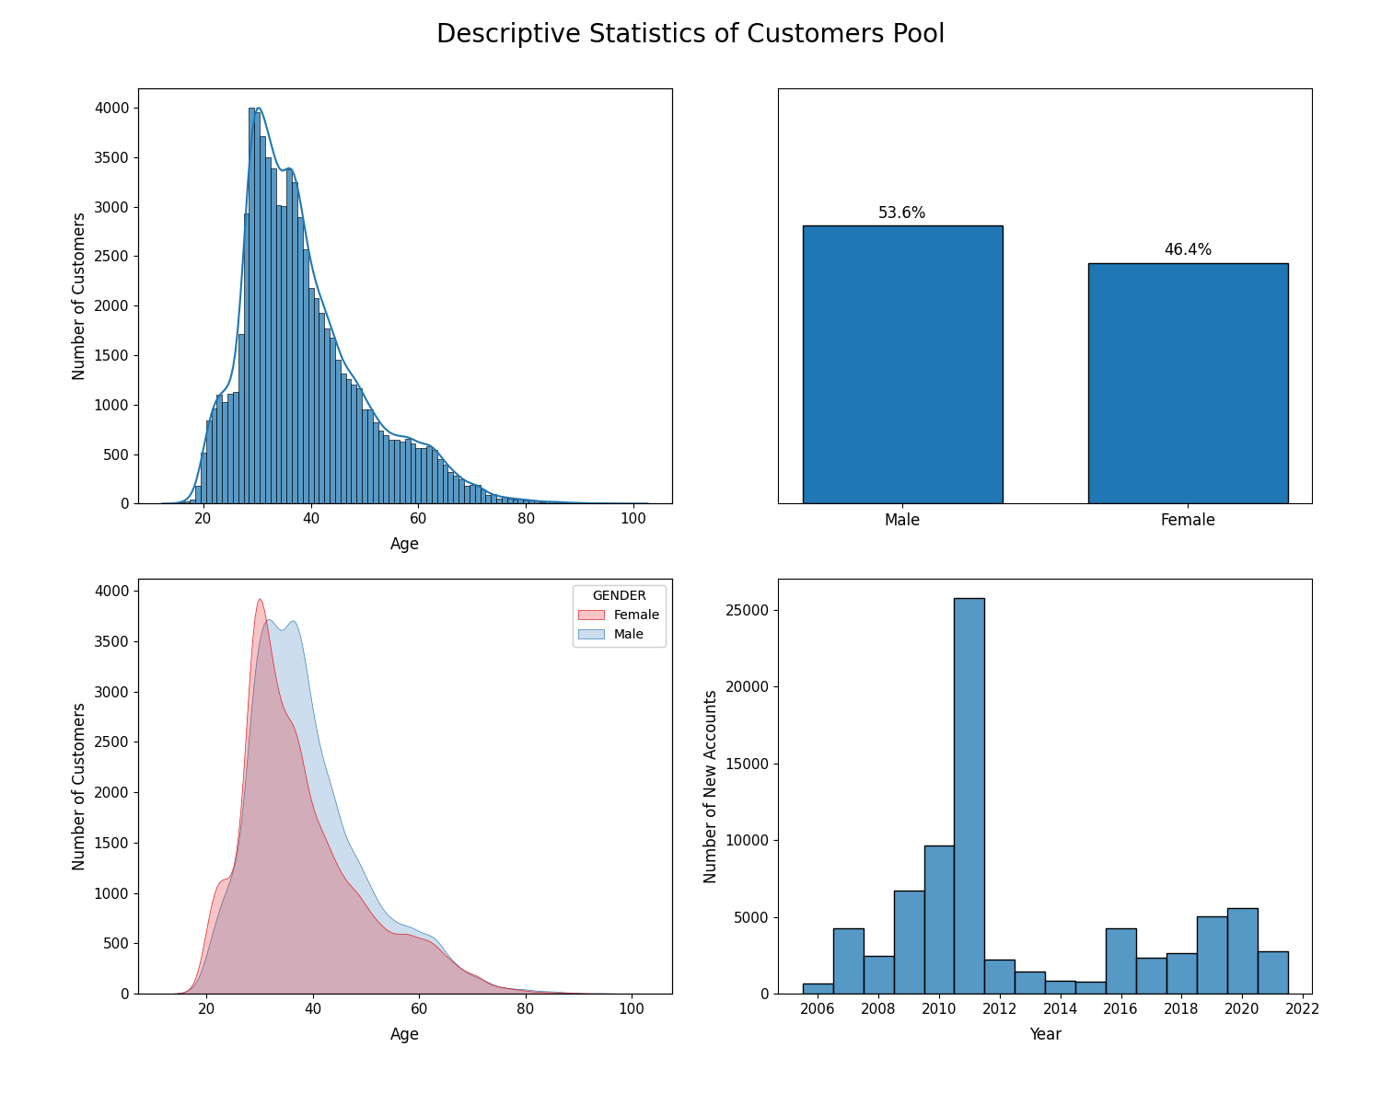
Analysis:
(Chart 1) Our customers are quite young, usually aged from 25 to 40 years old.
(Chart 1) The company policy requires a customer to be at least 16 years old to open an account. As a result, the age distribution is bound downward at 16. On the contrary, there is no upper bound for age; hence, the age distribution exhibits a fat right tail.
(Chart 2) Our customers are equally distributed in term of gender. There is only minor gap between the two.
(Chart 3) While numbers of customers in two sex are somewhat identical, male customers are fairly older than female customers.
(Chart 4) Number of new accounts rised tremendously from 2009 to 2011, then the number dropped during the period of 2012-2015 and recovered back to the normal level since 2016.

Slide 3
Margin Usage

Slide 4
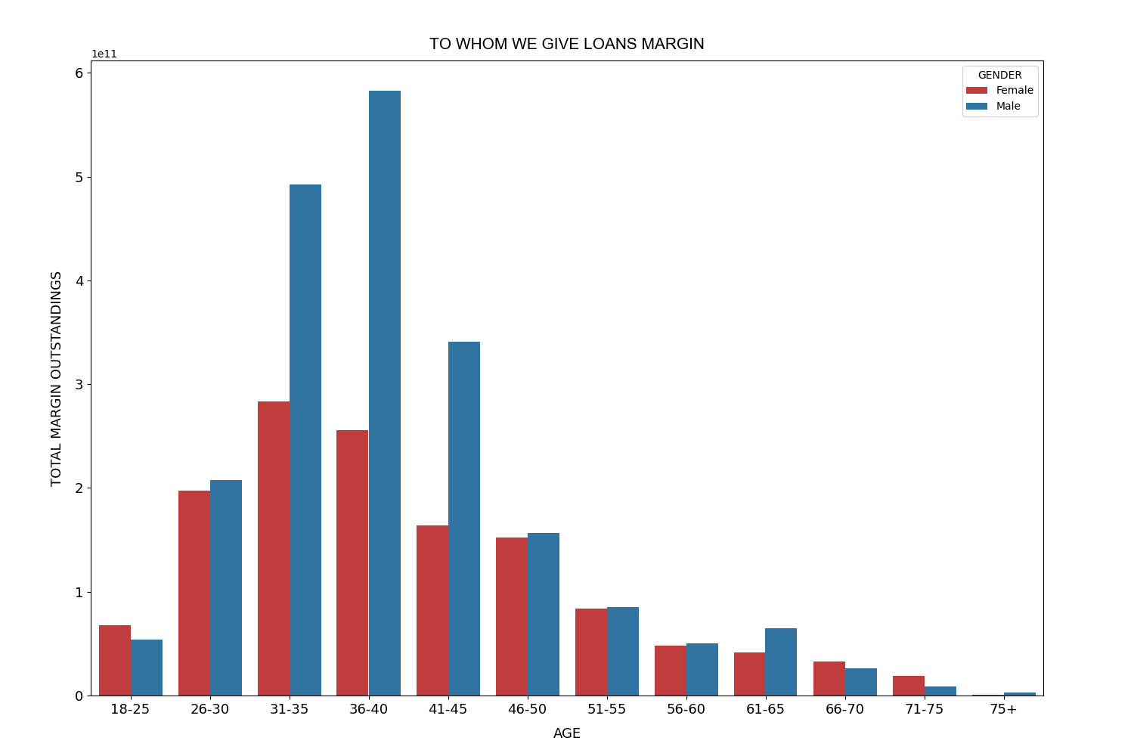
Analysis:
Customers aged from 31 to 45 consume most of margin loan amount. This might be due to the fact that customers mostly in this age range.
Male customers use more margin than female customers in term of total value.

Slide 5
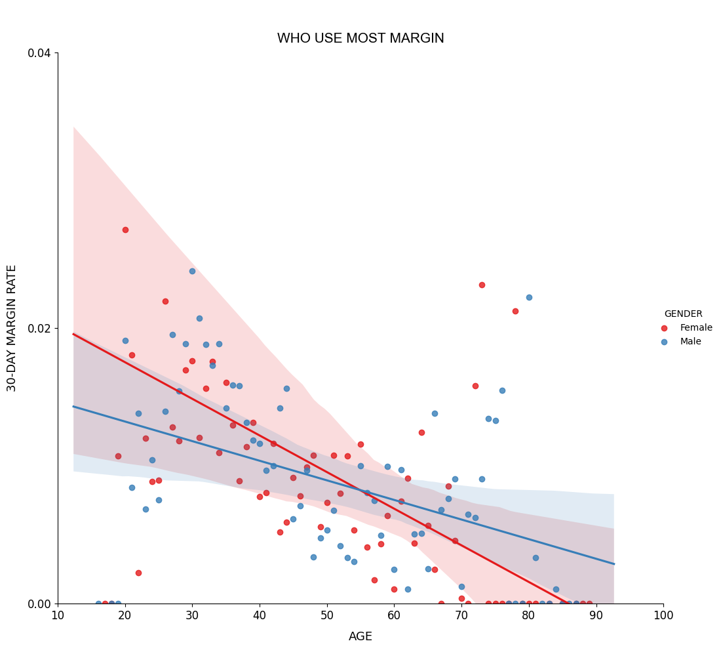
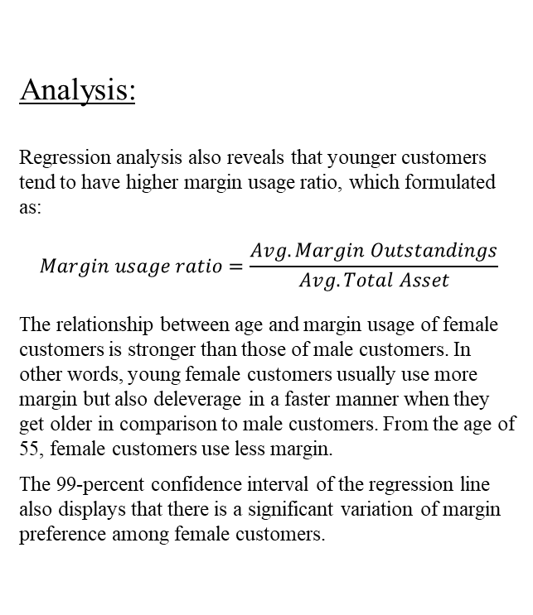
Analysis:
Regression analysis also reveals that younger customers tend to have higher margin usage ratio, which formulated as:
$$Margin usage ratio=\frac{Avg. Margin Outstandings}{Avg. Total Asset}$$
The relationship between age and margin usage of female customers is stronger than those of male customers. In other words, young female customers usually use more margin but also deleverage in a faster manner when they get older in comparison to male customers. From the age of 55, female customers use less margin.
The 99-percent confidence interval of the regression line also displays that there is a significant variation of margin preference among female customers.

Slide 6
Trading Frequency

Slide 7
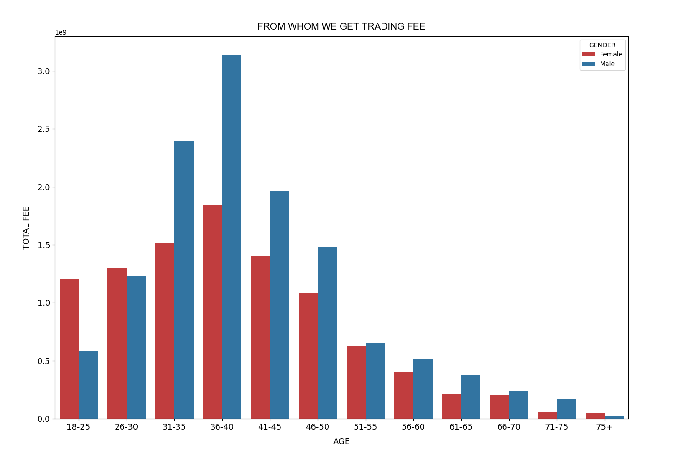
Analysis:
Customers aged from 31 to 45 also contribute a significant part of our fee income. This might be due to the fact that customers mostly in this age range.
Male customers tend to incur more trading fee in term of total value.

Slide 8
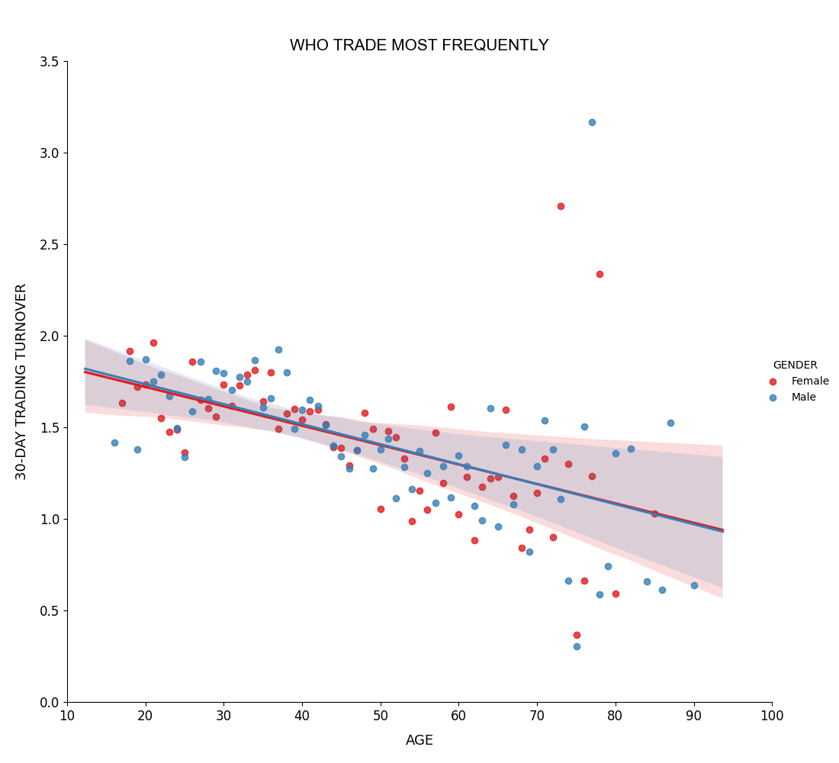
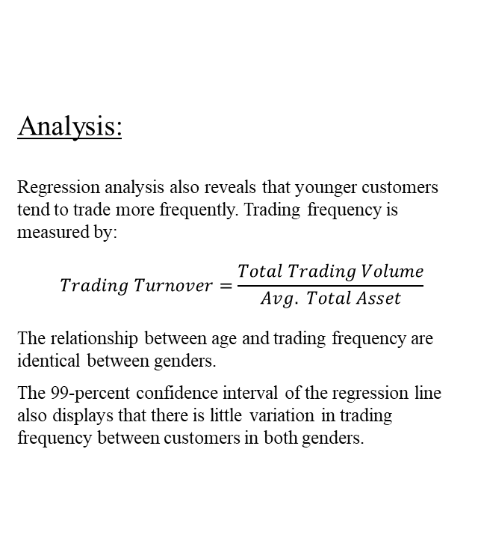
Analysis:
Regression analysis also reveals that younger customers tend to trade more frequently. Trading frequency is measured by:
$$Trading Turnover=\frac{Total Trading Volume}{Avg. Total Asset}$$
The relationship between age and trading frequency are identical between genders.
The 99-percent confidence interval of the regression line also displays that there is little variation in trading frequency between customers in both genders.

Slide 9
Conclusion

Slide 10
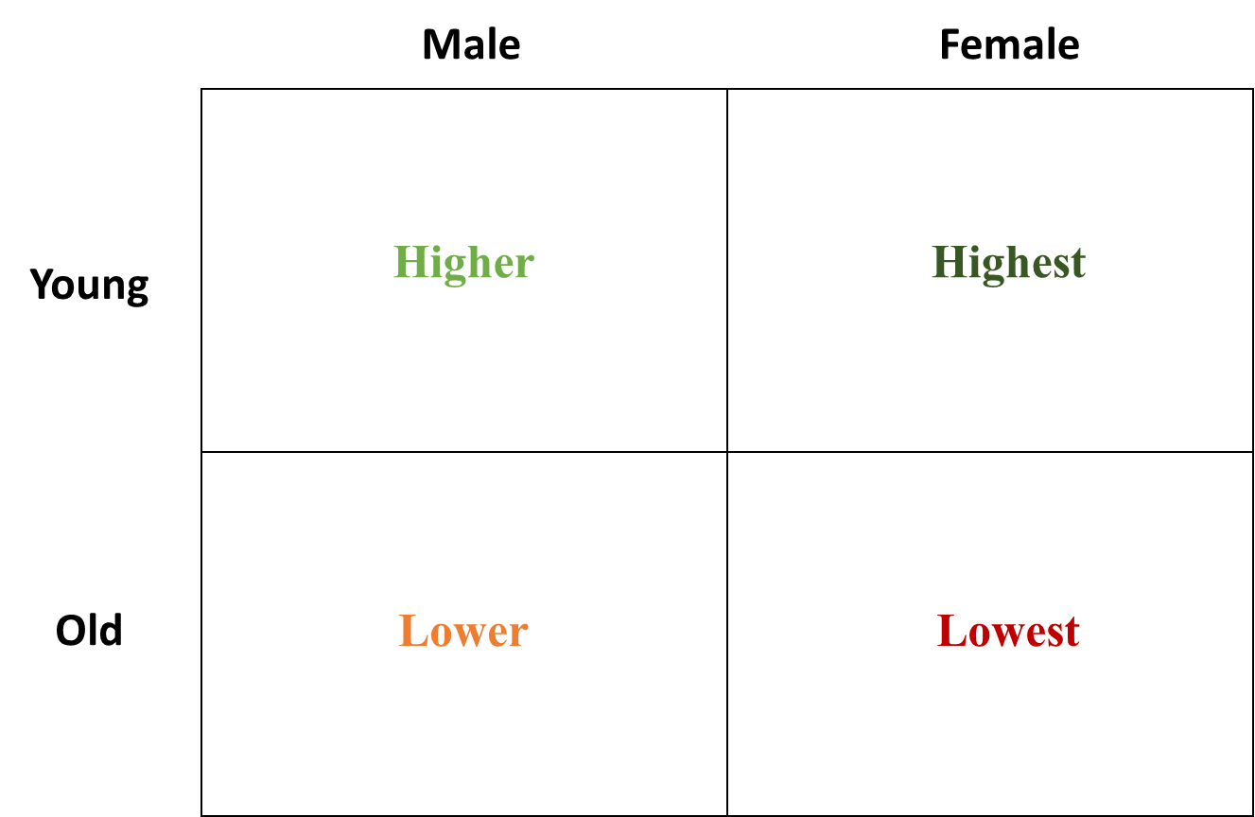
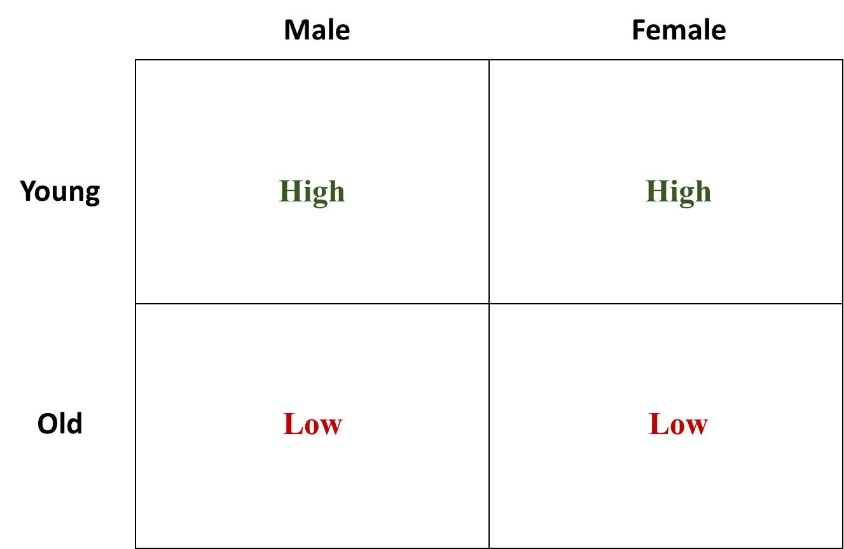
Who use higher margin:
Who have high trading frequency:

Slide 11
Who use higher margin?
Male
Female
Higher
Highest
Young
Old
Lower
Lowest

Slide 12
Who trade more often?
Male
Female
Young
High
High
Old
Low
Low

